Slide 1
Laplace Transform Analysis
Linear Circuit Analysis II
EECE 202 – Spring 2025

Slide 2
Announcement
Project Proposal will be released this week
Form project groups by the end of this week
Quiz during Week 4

Slide 3
Recap
Overview of Partial Fraction Expansions
Applying the Inverse Laplace Transform to the Decomposed Terms
New Material
Types of Partial Fraction Expansions
Repeated Poles
Applying the Inverse Laplace Transform to the Decomposed Terms

Slide 4
Learning Outcomes
2. an ability to compute responses of linear circuits with and without initial conditions via one-sided Laplace transform techniques. SO [1]

Slide 5
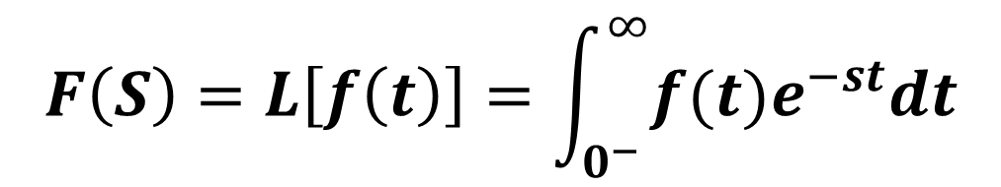
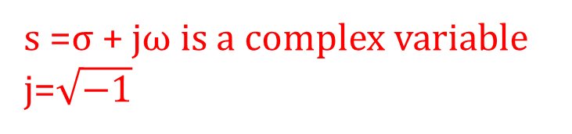
Laplace Transform Analysis
The Laplace Transform of a Signal, a Function, or an Excitation is given by:
$$F\left(S\right)=L\left[f\left(t\right)\right]=\int_{0^{−}}^{∞}{f(t)e^{−st}dt}$$
s =σ + jω is a complex variable
j=$\sqrt{−1}$

Slide 6






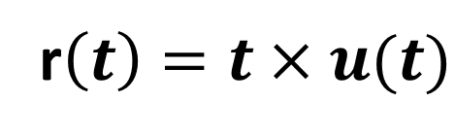
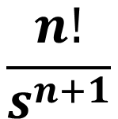
Time domain Laplace domain
$$\frac{1}{s}$$
$$u\left(t\right)$$
$$\frac{1}{s^{2}}$$
r$\left(t\right)=t×u(t)$
$$\frac{2}{s^{3}}$$
$$t^{2}×u(t)$$
$$\frac{n!}{s^{n+1}}$$
$$t^{n}×u(t)$$

Slide 7

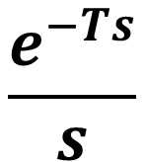


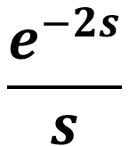

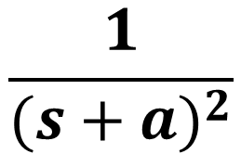
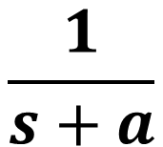
Time domain Laplace domain
$$\frac{e^{−Ts}}{s}$$
$$u\left(t−T\right)$$
$$\frac{e^{−2s}}{s}$$
$$u\left(t−2\right)$$
$$\frac{1}{s+a}$$
$$e^{−at}×u(t)$$
$$\frac{1}{{(s+a)}^{2}}$$
$$e^{−at}×r(t)$$

Slide 8




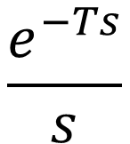

Laplace transform properties
Time shift property
$$\frac{1}{s}$$
$$u\left(t\right)$$
$$\frac{e^{−Ts}}{s}$$
$$u\left(t−T\right)$$
Frequency shift property
$$e^{−at}×f(t)$$
$$F(s+a)$$

Slide 9
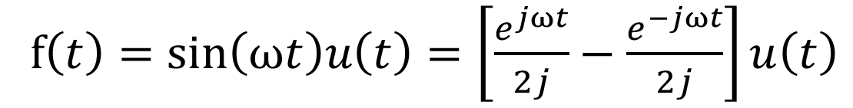
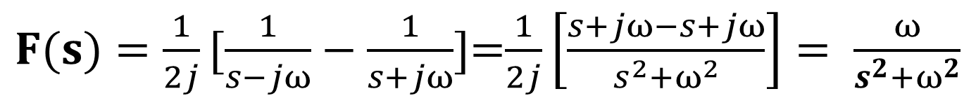
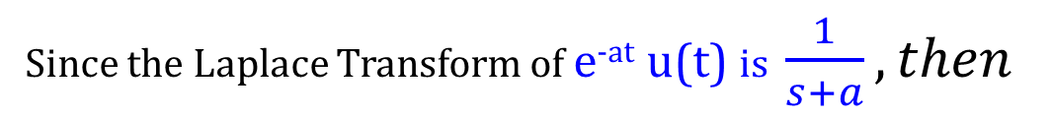
Example 12.17 (p. 576)
Find F(s) = L[ f (t)] when f (t) = sin(ωt)u(t).
Apply Euler formula: for t ≥ 0
f$\left(t\right)=\sin\left(\text{ω}t\right)u\left(t\right)=\left[\frac{e^{jωt}}{2j}−\frac{e^{−jωt}}{2j}\right]u\left(t\right)$
Since the Laplace Transform of e^{-at} u(t) is $\frac{1}{s+a}, then$
$F(s){=\frac{1}{2j}[\frac{1}{s−jω}−\frac{1}{s+jω}]}$=$\frac{1}{2j}\left[\frac{s+jω−s+jω}{s^{2}+ω^{2}}\right]= \frac{ω}{s^{2}+ω^{2}}$

Slide 10
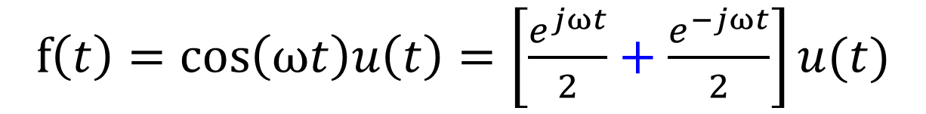
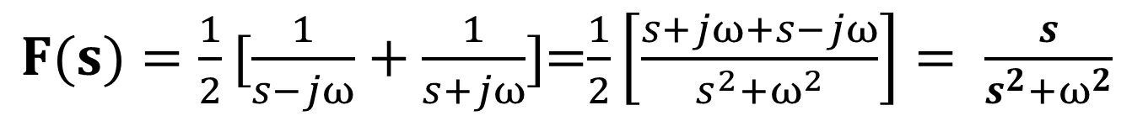
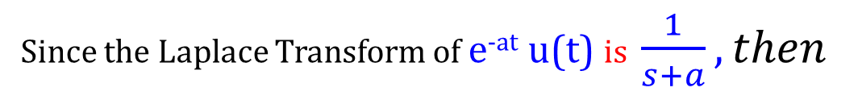
Exercise (p. 576)
Find F(s) = L[ f (t)] when f (t) = cos(ωt)u(t).
Apply Euler formula: for t ≥ 0
Recall LT properties and LT pairs
f$\left(t\right)=\cos\left(ωt\right)u\left(t\right)=\left[\frac{e^{jωt}}{2}+\frac{e^{−jωt}}{2}\right]u(t)$
Since the Laplace Transform of e^{-at} u(t) is $\frac{1}{s+a}, then$
$F(s){=\frac{1}{2}[\frac{1}{s−jω}+\frac{1}{s+jω}]}$=$\frac{1}{2}\left[\frac{s+jω+s−jω}{s^{2}+ω^{2}}\right]= \frac{s}{s^{2}+ω^{2}}$

Slide 11
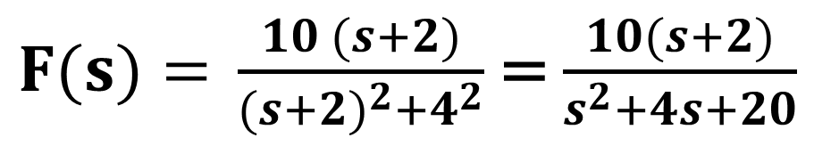
Additional example 3
Find F(s) for the following function f(t)=10e^{-2t} cos(4t) u(t)
$F(s){=} \frac{10 (s+2)}{({s+2)}^{2}+4^{2}}$ = $\frac{10(s+2)}{s^{2}+4s+20}$

Slide 12
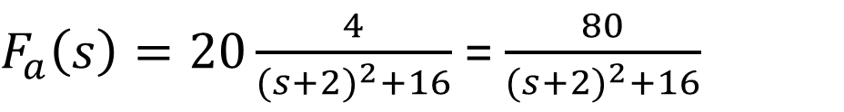
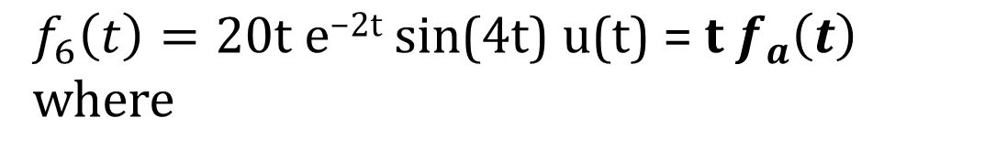
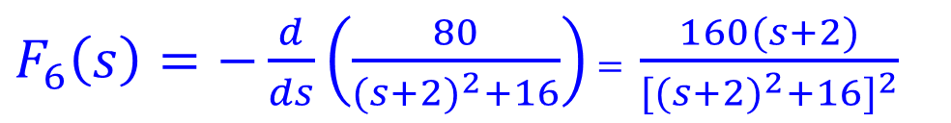
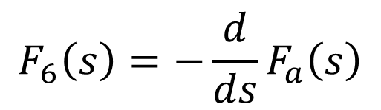
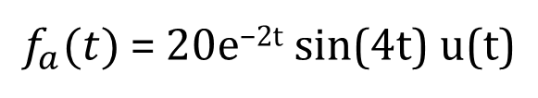
Additional example 4
Find F₆(s) for the following function f₆(t)=20t e^{-2t} sin(4t) u(t)
$f_{6}\left(t\right)=\text{20}\text{t} \text{e}\text{−2}\text{t} \text{sin}\text{(}\text{4}\text{t}\text{)} \text{u}\text{(}\text{t}\text{) = }\text{t}{ f}_{a}\left(t\right)$ where
$f_{a}(t)$ = $20\text{e}\text{−2}\text{t} \text{sin}\text{(}\text{4}\text{t}\text{)} \text{u}\text{(}\text{t}\text{)}$
$F_{a}\left(s\right)=20\frac{4}{(s+2)^{2}+16}$ = $\frac{80}{(s+2)^{2}+16}$
$$F_{6}\left(s\right)=−\frac{d}{ds}F_{a}\left(s\right)$$
$F_{6}\left(s\right)=−\frac{d}{ds}\left(\frac{80}{(s+2)^{2}+16}\right)$ $=$ $\frac{160(s+2)}{[(s+2)^{2}+16]^{2}}$

Slide 13
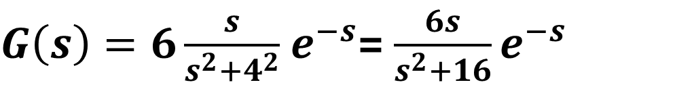
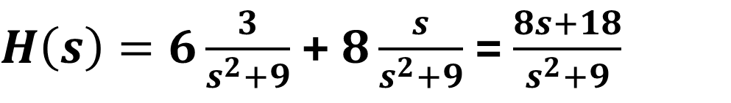
Example 5
Find the Laplace transforms for: g(t) = 6cos (4(t −1))u(t-1)
$G\left(s\right)=6\frac{s}{s^{2}+4^{2}}$ $e^{−s}$= $\frac{6s}{s^{2}+16}e^{−s}$
Example 6
Find the Laplace transforms for: h(t) = (6sin(3t)+ 8cos(3t))u(t)
$H\left(s\right)=6\frac{3}{s^{2}+9}$ + $8\frac{s}{s^{2}+9}$ = $\frac{8s+18}{s^{2}+9}$

Slide 14
Practice
Explain how the Laplace Transform simplifies solving differential equations. Explain the significance of the time-shift property of the Laplace transform and how it applies to a delayed signal.
How does the frequency shift property affect the Laplace transform of a sinusoidal signal?
Discuss the importance of initial conditions when solving linear circuit problems using Laplace transforms.
Solve activity on Moodle

Slide 15
Summary
Transforms a time-domain function into the s-domain for easier analysis of linear systems.
Key Properties:
Linearity:
Time Shift:
Frequency Shift
Applications in Circuit Analysis:
Helps in analyzing systems with initial conditions.
Used to solve differential equations by transforming them into algebraic equations.
Suggested Additional Problems for Ch. 12:
Exercises 1, 2, 4, 6 (p. 592), 16, 17 (p. 595) ?

